Slide 1
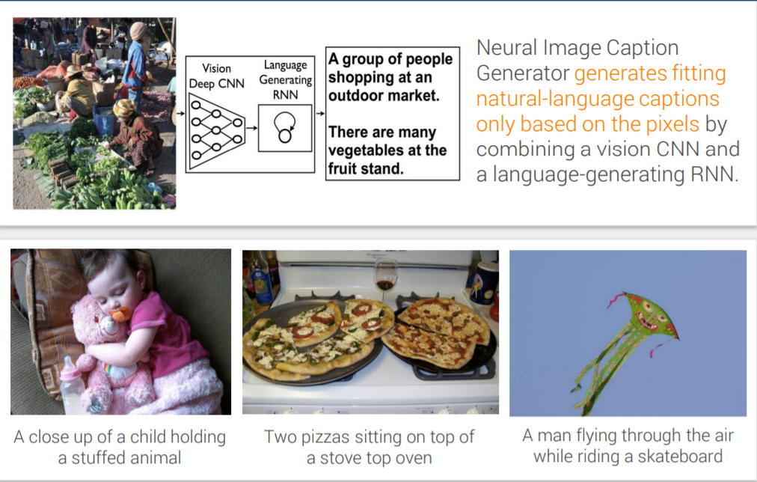
AI-Image Caption Bot
By
Vandit Gupta
43514802717
C-7

Slide 2
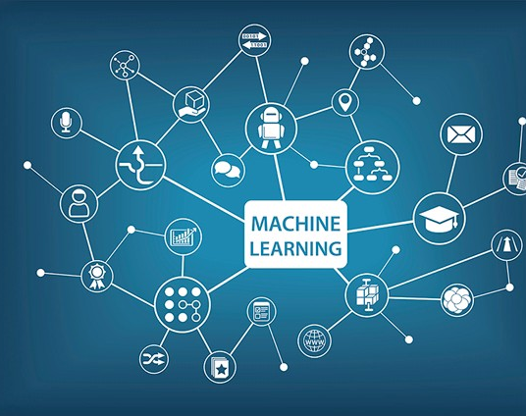
Machine Learning
Machine learning (ML) is the scientific study of algorithms and statistical models that computer systems use to perform a specific task without using explicit instructions, relying on patterns and inference instead. It is a subset to artificial intelligence.
The types of machine learning algorithms differ in their approach, the type of data they input and output, and the type of task or problem that they are intended to solve.
Some of the common types of machine learning algorithms are:
Supervised Learning
Unsupervised Learning
Reinforcement learning

Slide 3
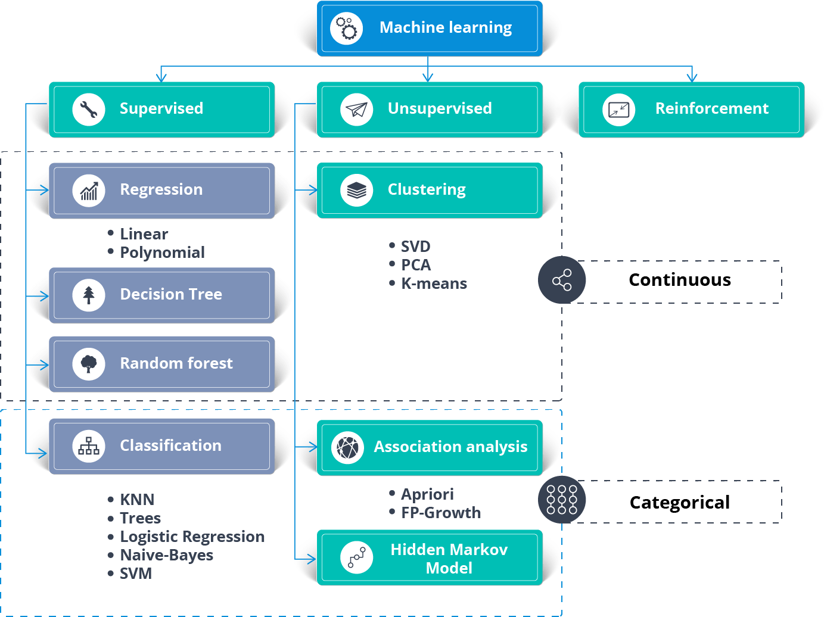
Some Machine Learning Algorithms
Machine Learning algorithms are methods which are problem specific. These algorithms can be used to solve some of the real-life common problems.
Some of the common machines learning algorithms are:
K-Nearest Neighbours
K-Means
Linear Regression
Logistic Regression
Naive Bayes
Decision Trees
Random Forest

Slide 4
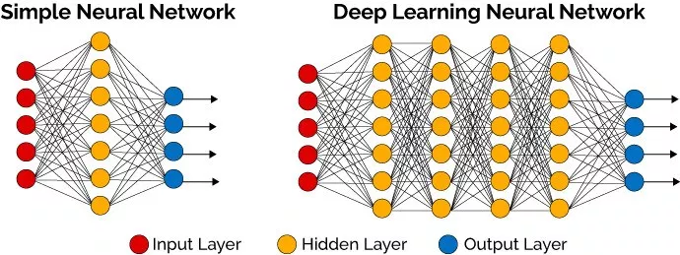
Deep Learning
Deep learning is a subpart of artificial intelligence that imitates the workings of the human brain in processing data and creating patterns for use in decision making. Deep learning has networks capable of learning extensive patterns, correlations and patterns from the network.
A deep neural network consists of a hierarchy of layers, whereby each layer transforms the input data into more abstract representations (e.g. edge -> nose -> face). The output layer combines those features to make predictions.

Slide 5
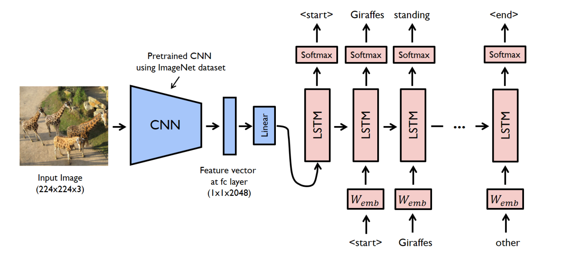
Introduction to AI-Caption Bot
Image Captioning is a project on Machine Learning and Deep Learning . It is an example of supervised learning problem. With the help of this project, the machine can generate its own captions related to the image. The model uses Flickr8k dataset for training data and uses CNN for extracting features of image and LSTM for training.

Slide 6
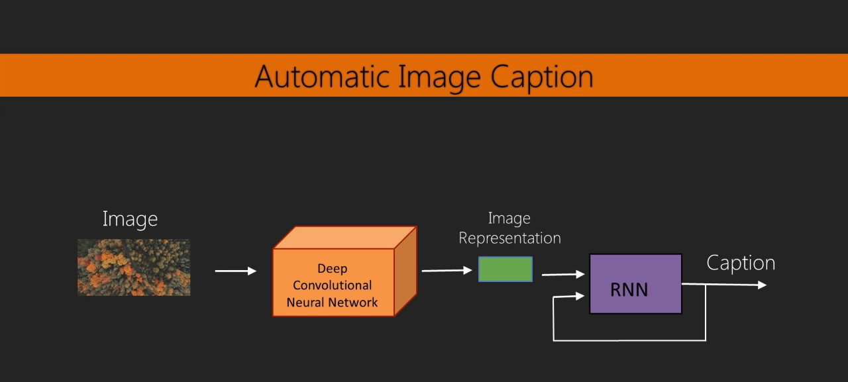
Dataset Used
Flickr8 dataset is a dataset which has photos (in .jpeg) format and each photo has 5 captions associated with it which are stored in token.txt file.
After we extract the dataset, there are 2 new folders created which are :
1. Flickr8k_Dataset: Contains a total of 8092 images in JPEG format with different shapes and sizes. Of which 6000 are used for training, 1000 for test and 1000 f or development.
2. Flickr8k_text : Contains text files describing train_set ,test_set. Flickr8k.token.txt contains 5 captions for each image i.e. total 40460 captions.

Slide 7
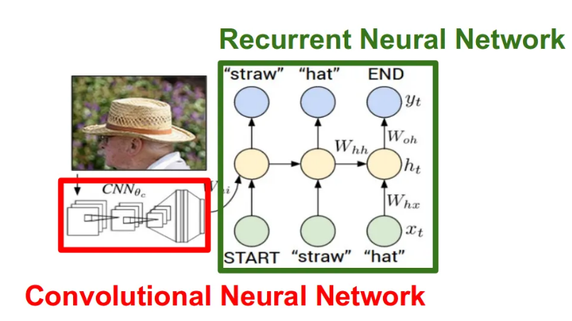
Algorithms used In Project
The task of image captioning can be divided into two modules logically :
One is an image based model – which extracts the features out of the images, and the other is a language based model – which translates the features and objects given by our image based model to a natural sentence.
These models are applied using the following algorithms:
Convolutional Neural Networks (CNNs)
Long-Short Term Memory (LSTMs)

Slide 8
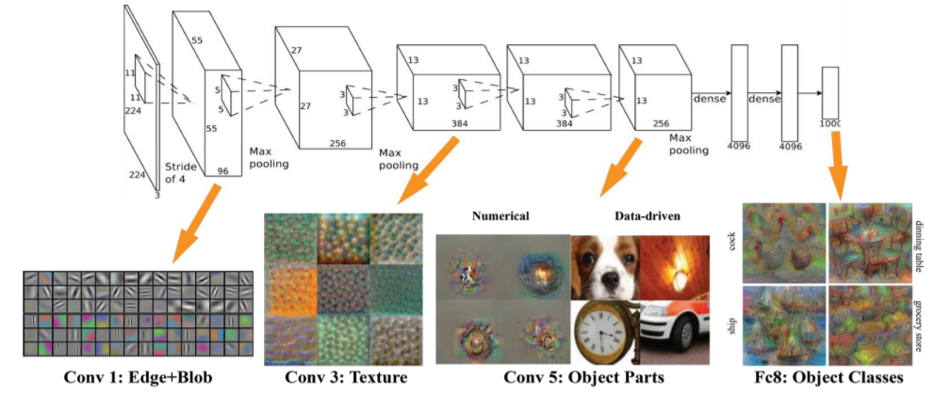
Convolution Neural Network(CNN)
Convolutional Neural Networks (ConvNets or CNNs) are a category of Neural Networks that have proven very effective in areas such as image recognition and classification. ConvNets have been successful in identifying faces, objects and traffic signs apart from powering vision in robots and self-driving cars. ConvNets can also be used for Radio Imaging which helps in disease detection.

Slide 9

Long short term memory(LSTM)
LSTMs are a special kind of RNN(recurrent neural network), capable of learning long-term dependencies whereas RNN fails to hold the memory for a longer period of time.
LSTMs have a chain like structure, but the repeating module has a different structure. Instead of having a single neural network layer, there are four NN layer, interacting in a very special way.
There are three different gates in LSTM that regulate information flow in an LSTM cell. A forget gate, input gate, and output gate.

Slide 10
Working of Project
First we split the data into 3 files namely flickr_8k_train_dataset.txt, flickr_8k_val_dataset.txt, flickr_8k_test_dataset.txt. Then we split the token.txt into image name and its corresponding sentence.
Then we write the image names with their corresponding sentences into these 3 files and tokenize the file by adding <start> at the starting of each sentence and <end> at the end of each sentence.
Then we create embeddings for both images(CNN) and the captions (vectorization). The vocabulary is calculated from the annotations provided with the data that contains all the words from the image captions. The most frequent words are treated as unique. The embedding weights are learned during training. The decoder consists of one LSTM layer and is the recurrent in the RNN.
Lastly we train the LSTM and find the relevant captions of the images.

Slide 11
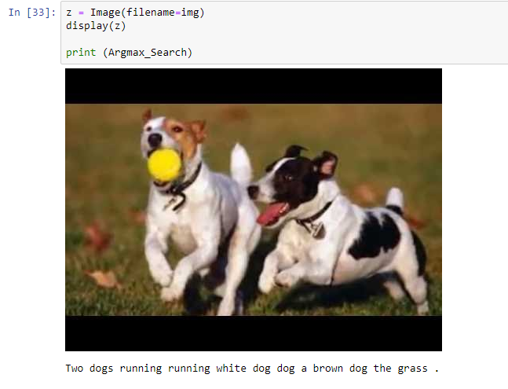
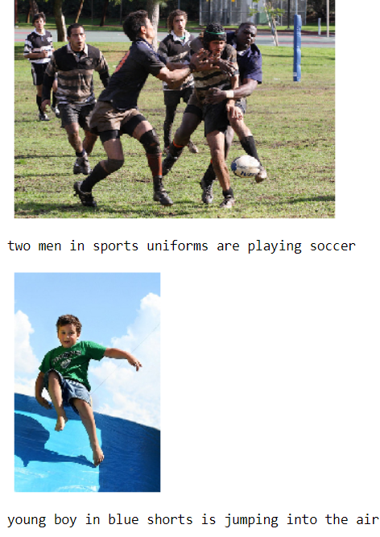
Code snippets and output

Slide 12
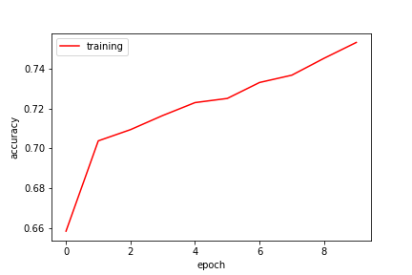
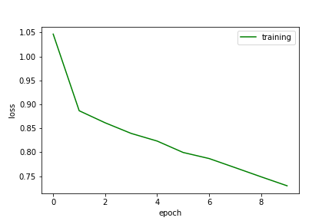
Accuracy plot
Loss plot

Slide 13
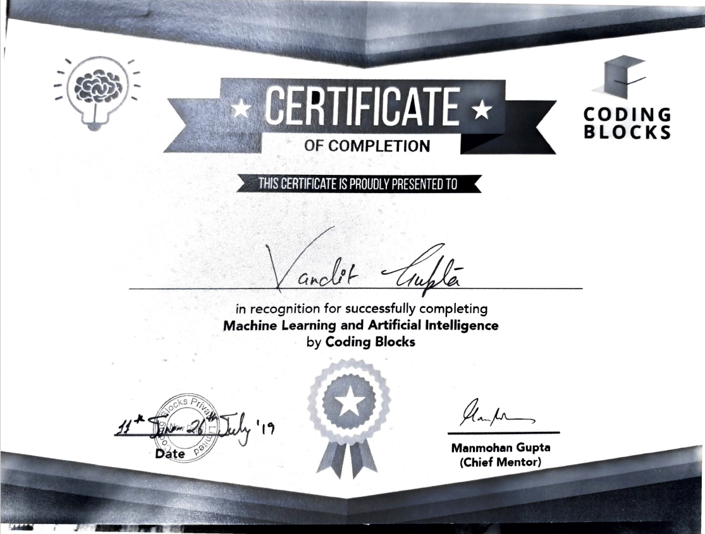
Certification of completion of course

Slide 14
THANK YOU

